Slide 1

DEPARTMENT OF COMPUTER SCIENCE AND ENGINEERING
Multimodal Emotion Recognition with Adaptive Fusion and Reliability-Aware Attention using Lightweight Transformer Architectures
S.NO | NAME | ROLL NO.
1. | V M S Sainath Chakravadhanula | 160722733010
Under the Guidance of
Mr. Mujthaba Gulam Muqeeth
Assoc. Prof, Dept. of CSE
Coordinator:
Mr. Mujthaba Gulam Muqeeth Assoc. Prof, Dept. of CSE
Batch No :
25-H8CS21A01

Slide 2

ABSTRACT
Human emotions are expressed through a complex combination of speech, verbal cues, and language, making their automated recognition a challenging multimodal problem. Existing transformer-based emotion recognition systems achieve high accuracy but often suffer from heavy computational requirements, vulnerability to noisy or missing modalities, and poor generalization to underrepresented emotion classes. This project proposes a hybrid transformer framework that achieves lightweight cross-modal fusion and enhanced robustness through adaptive attention mechanisms and reliability-aware feature weighting. To further address class imbalance, the model incorporates targeted data augmentation strategies for low-resource emotion categories, improving diversity and stability in training. The system will be evaluated on benchmark datasets such as CMU-MOSEI and IEMOCAP, comparing efficiency, robustness, and accuracy against existing multimodal transformers. The outcome aims to deliver a resource-efficient, noise-tolerant, and generalizable approach to multimodal emotion understanding-pushing toward practical, real-world deployment in affective computing and human-AI interaction systems.
Department of Computer Science and Engineering, MCET

Slide 3
INTRODUCTION
The project will aim to develop an intelligent multimodal framework for recognizing human emotions by integrating information from speech, facial expressions, and textual cues.
We will leverage fusion transformer architectures to learn deep cross-modal relationships that enable the model to interpret complex emotional states more accurately and contextually.
The system will incorporate lightweight attention mechanisms and modality reliability estimation to ensure computational efficiency and robustness against noisy or missing inputs.
To enhance performance on underrepresented emotions, the framework will include targeted data augmentation techniques that improve generalization across diverse and low-resource categories.
A proof-of-concept application will demonstrate the end-to-end workflow—from multimodal feature extraction to real-time emotion prediction—highlighting potential use cases in human–AI interaction, mental health analysis, and adaptive learning environments.
The project will establish a modular and scalable foundation for future extensions in affective computing, enabling more empathetic, reliable, and human-centered AI systems.
Department of Computer Science and Engineering, MCET

Slide 4
MOTIVATION
The ability to understand human emotions accurately is central to improving human-computer interaction, mental health analysis, and social robotics. However, existing emotion recognition systems often rely on a single modality such as text or speech, which limits their contextual understanding.
In real-world conditions, emotional cues appear across multiple channels - voice tone, facial expression, and linguistic content - and may be noisy, incomplete, or contradictory. Current models struggle to integrate these signals effectively, leading to inconsistent or biased interpretations.
Transformer-based multimodal approaches have shown strong performance, but they are often computationally heavy and sensitive to missing or corrupted data, making them unsuitable for real-time or edge deployment.
Moreover, emotion datasets are typically imbalanced, with rare emotions like disgust, surprise, or fear underrepresented, resulting in poor generalization and skewed performance.
The proposed project aims to overcome these limitations by developing a lightweight, robust fusion transformer framework that can handle noisy or missing modalities and improve recognition accuracy for low-resource emotion categories through targeted data augmentation.
Department of Computer Science and Engineering, MCET

Slide 5
STATISTICAL DATA
Studies in Affective Computing indicate that over 70% of human communication is non-verbal, conveyed through tone, facial expression, and body language, while text alone captures less than 10% of emotional intent. This underscores the importance of multimodal analysis in emotion understanding.
According to a 2023 Gartner AI report, nearly 58% of human-AI interaction systems fail to interpret user emotions accurately, leading to poor user satisfaction and engagement.
The World Health Organization (WHO) estimates that one in eight people globally live with a mental health condition. AI-assisted emotional analysis tools have shown potential to support early stress or depression detection.
Data imbalance continues to hinder progress in emotion recognition - public datasets like CMU-MOSEI and IEMOCAP show that minority emotions (such as disgust, fear, or surprise) appear in less than 8-10% of total samples, causing biased model learning and weak generalization.
Computational inefficiency is a major bottleneck in deploying multimodal transformer models: a 2024 benchmark study found that average inference latency for large fusion models exceeds 500 ms per input, making them impractical for real-time or mobile deployment.
Department of Computer Science and Engineering, MCET

Slide 6
LITERATURE SURVEY
S.no | Paper Title | Author(s) & Year | Domain / Focus | Technique / Approach | Advantages / Key Findings | Limitations | Relevance to Project
1 | Towards Robust Multimodal Emotion Recognition under Missing Modalities and Distribution Shifts (CIDer) | Wenhao Zhong, Weizhi Xue, Zhaohui Yan, et al. (2025) | Multimodal Emotion Recognition (Text, Audio, Visual) | Causal Inference Distiller (CIDer) — combines causal reasoning, self-distillation, and attention-based fusion | Achieved state-of-the-art accuracy (Macro-F1 ≈ 83%) on CMU-MOSEI; highly robust under missing modalities | High computational complexity; lacks augmentation and low-resource emotion handling | Base paper — addresses robustness but leaves gaps in efficiency and data imbalance, which this project targets
2 | Transformer-Based Adaptive Cross-Modal Fusion Network (TACFN) | Feng Liu, Ziyu Wang, Y. Zhao, et al. (2025, IEEE Transactions on Affective Computing) | Multimodal Emotion Analysis (Audio, Visual, Text) | Adaptive cross-modal attention with redundancy suppression | Lightweight model (~0.4M parameters) with improved efficiency and performance; reduced redundant features | Limited robustness testing; no data augmentation for minority classes | Supports the lightweight and efficient fusion component of our framework
3 | Modality Augmentation and Interaction via Multimodal Dimension Transformation (AIMDiT) | Sheng Wu, Ming Chen, Y. Zhang, et al. (2024, Elsevier KBS) | Emotion Recognition in Conversations (Text, Audio, Visual) | Inception-based dimension transformation (1D→2D→1D) + Modality Augmentation Network (MAN) | Enhanced interaction and augmentation between modalities; improved multimodal feature learning | Tested only on MELD (dialogue-level data); not validated for missing modality robustness | Reference for data augmentation and handling low-resource emotion categories
Department of Computer Science and Engineering, MCET

Slide 7
LITERATURE SURVEY
S.no | Paper Title | Author(s) & Year | Domain / Focus | Technique / Approach | Advantages / Key Findings | Limitations | Relevance to Project
4 | Multi-Label Multimodal Emotion Recognition with Transformer-Based Fusion | Duc H. Le, Son T. Truong, H. Nguyen (2023, IEEE Access) | Multilabel Emotion Recognition (Text, Audio, Visual) | Label-aware transformer fusion using emotion-level embeddings | Improved multi-label prediction; captures emotion co-occurrence effectively | Computationally expensive; limited generalization for unseen speakers | Basis for emotion-level representation learning and multi-emotion classification design
5 | MuMTAffect: A Multimodal Multitask Affective Framework for Personality and Emotion Recognition | Mohammad Jamshidi, Shiqi Gao, et al. (2025) | Affective Computing (Physiological Modalities) | Multimodal multitask transformer (emotion + personality prediction) | Demonstrated joint learning improves overall generalization and stability | Uses physiological data (GSR, pupil) — limited domain relevance for audiovisual data | Conceptual reference for multitask modular transformer design and generalization ideas
6 | Detecting Expressions with Multimodal Transformers | Sarath Parthasarathy, Shiva Sundaram (2020, Amazon Lab 126) | Audio-Visual Emotion Recognition | Cross-modal attention transformer (2-modality) | Better arousal-valence estimation; robust to partial modality dropout | Only two modalities; lacks text and large-scale validation | Early robustness baseline showing benefits of transformer-based attention fusion
Department of Computer Science and Engineering, MCET

Slide 8
LITERATURE SURVEY
S.no | Paper Title | Author(s) & Year | Domain / Focus | Technique / Approach | Advantages / Key Findings | Limitations | Relevance to Project
7 | Multimodal Transformer Fusion for Continuous Emotion Recognition | Jian Huang, Meng Liu, et al. (2020, IEEE ICASSP) | Continuous Emotion Recognition (Regression) | Hybrid Transformer + LSTM fusion model | Introduced continuous valence/arousal modeling; improved temporal understanding | Outdated dataset (AVEC 2017); lacks tri-modal integration and noise handling | Historical baseline for early multimodal transformer fusion strategies
8 | Cross-Modal Transformer for Emotion-Aware Representation Learning | Hao Zhang, Rui Li, et al. (2024, AAAI/ArXiv) | Multimodal Emotion Recognition (Text, Audio, Visual) | Cross-modal consistency transformer with adaptive temporal refinement | Strong tri-modal fusion accuracy (~82% Weighted F1 on CMU-MOSEI); attention-based refinement improves robustness | High model size (~250M parameters); lacks targeted augmentation for rare classes | Recent complementary reference for cross-modal alignment and attention refinement
9 | MISA: Modality-Invariant and Specific Representations for Multimodal Sentiment Analysis | Devamanyu Hazarika, Amir Zadeh, Soujanya Poria (2020, ACL) | Multimodal Sentiment & Emotion Analysis | Dual-space learning — separates modality-invariant and specific embeddings | Improved interpretability and domain transfer; solid benchmark | High training complexity; no handling of missing modalities or imbalance | Foundational baseline for representation-level learning, inspires modality separation in our design
Department of Computer Science and Engineering, MCET

Slide 9
PROBLEM STATEMENT
Multimodal Emotion Recognition with Adaptive Fusion and Reliability-Aware Attention seeks to overcome the limitations of current multimodal emotion recognition systems - namely high computational overhead, vulnerability to missing modalities, and poor performance by developing a lightweight hybrid fusion transformer capable of efficient cross-modal learning, enhanced robustness, and improved generalization through adaptive attention mechanisms and targeted data augmentation.
Department of Computer Science and Engineering, MCET

Slide 10
OBJECTIVES
Develop a lightweight and robust multimodal transformer framework for accurate human emotion recognition across speech, facial, and textual modalities.
Design an efficient hybrid fusion mechanism using adaptive attention and parameter sharing to reduce computational overhead without compromising model accuracy.
Implementation of targeted Data Augmentation strategy to enhance performance on underrepresented emotion categories and improve cross-domain generalization.
Develop a proof-of-concept application to demonstrate the end-to-end workflow from multimodal feature extraction to real-time emotion prediction.
Department of Computer Science and Engineering, MCET

Slide 11
SCOPE OF THE PROJECT
Multimodal integration: combining textual, auditory, and visual modalities to achieve comprehensive emotion understanding.
Lightweight architecture design: implementing parameter-efficient hybrid transformer models that reduce computational load and enable real-time deployment.
Robustness enhancement: incorporating modality reliability estimation and modality dropout techniques to handle noisy or missing data inputs effectively.
Data augmentation for low-resource emotions: applying targeted augmentation and class-balancing strategies to improve recognition of rare or underrepresented emotional categories.
Cross-domain generalization: training and validating the system on multiple benchmark datasets to ensure scalability and adaptability
Prototype implementation: developing a proof-of-concept application that demonstrates end-to-end emotion recognition and visualization for applications in education, mental health monitoring, and human–AI interaction.
Department of Computer Science and Engineering, MCET

Slide 12
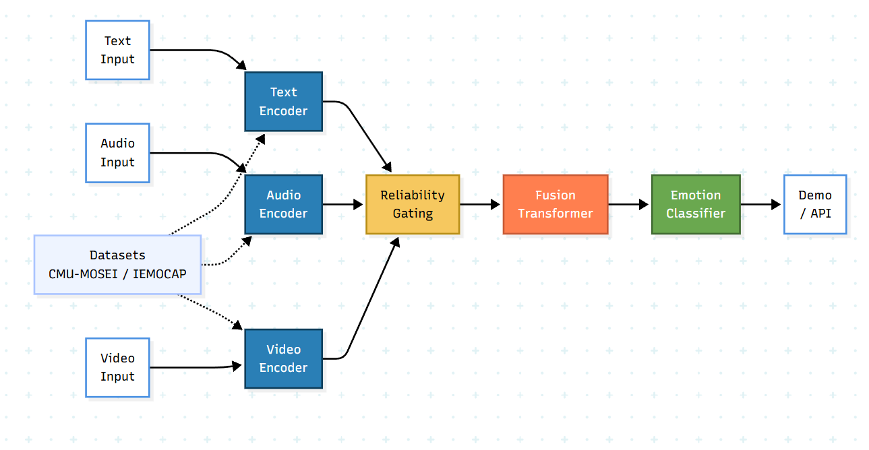
PROPOSED ARCHITECTURE
Department of Computer Science and Engineering, MCET

Slide 13
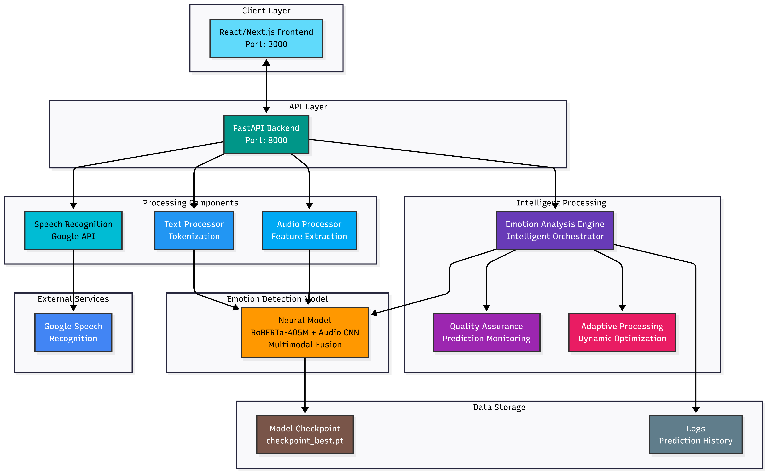
Finalized ARCHITECTURE
Department of Computer Science and Engineering, MCET

Slide 14
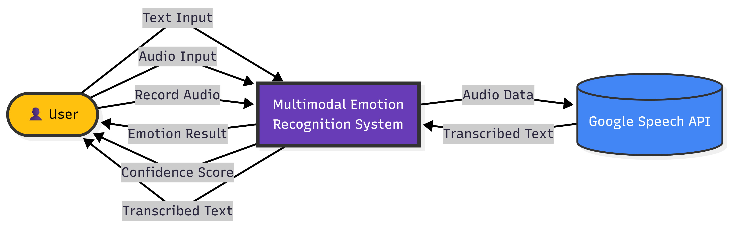
Data Flow Diagram- level 0
Department of Computer Science and Engineering, MCET

Slide 15
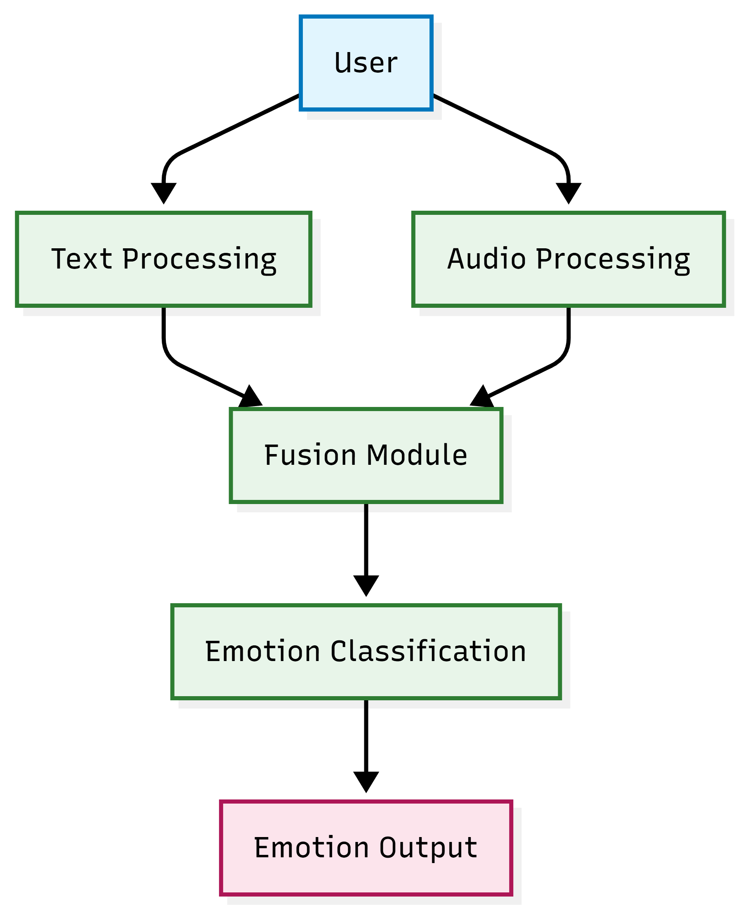
Data Flow Diagram- level 1
Department of Computer Science and Engineering, MCET

Slide 16
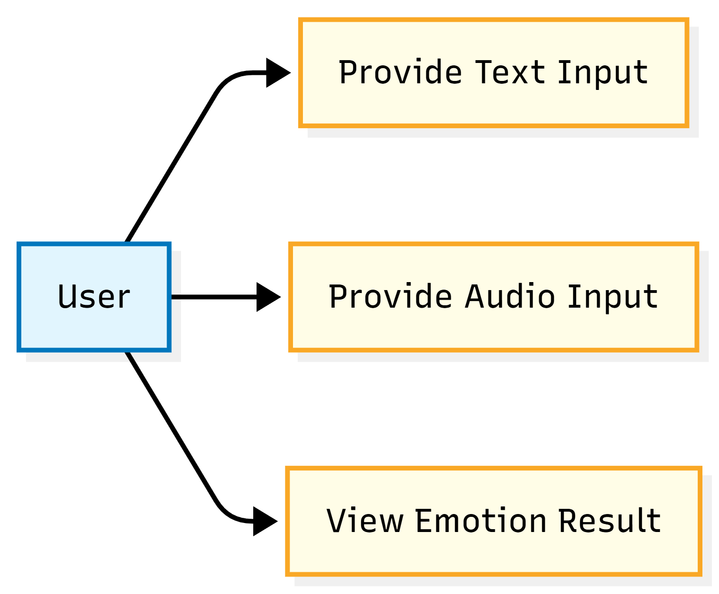
Use case Diagram
Department of Computer Science and Engineering, MCET

Slide 17
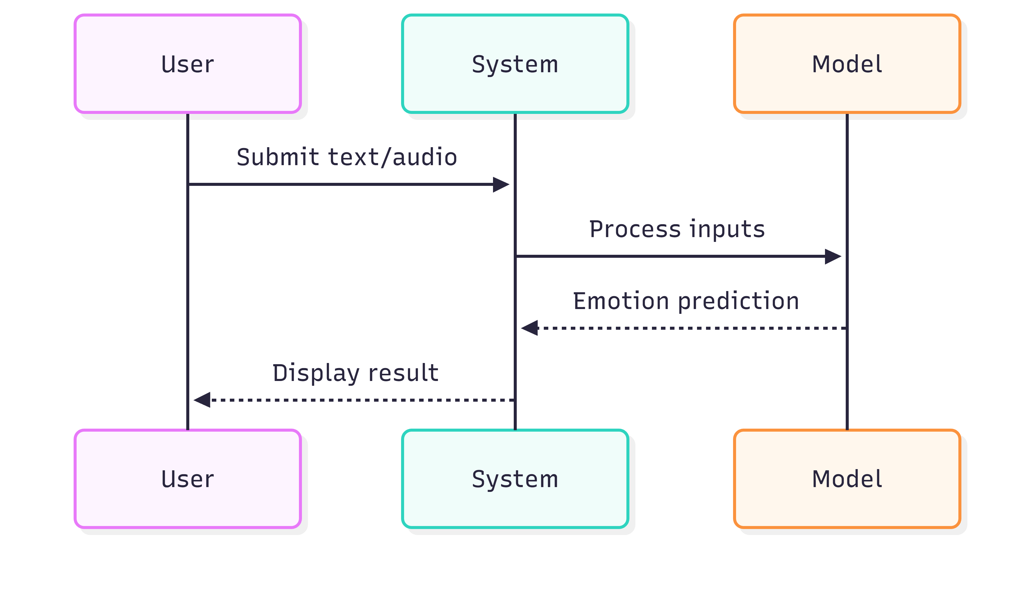
Sequence Diagram
Department of Computer Science and Engineering, MCET

Slide 18
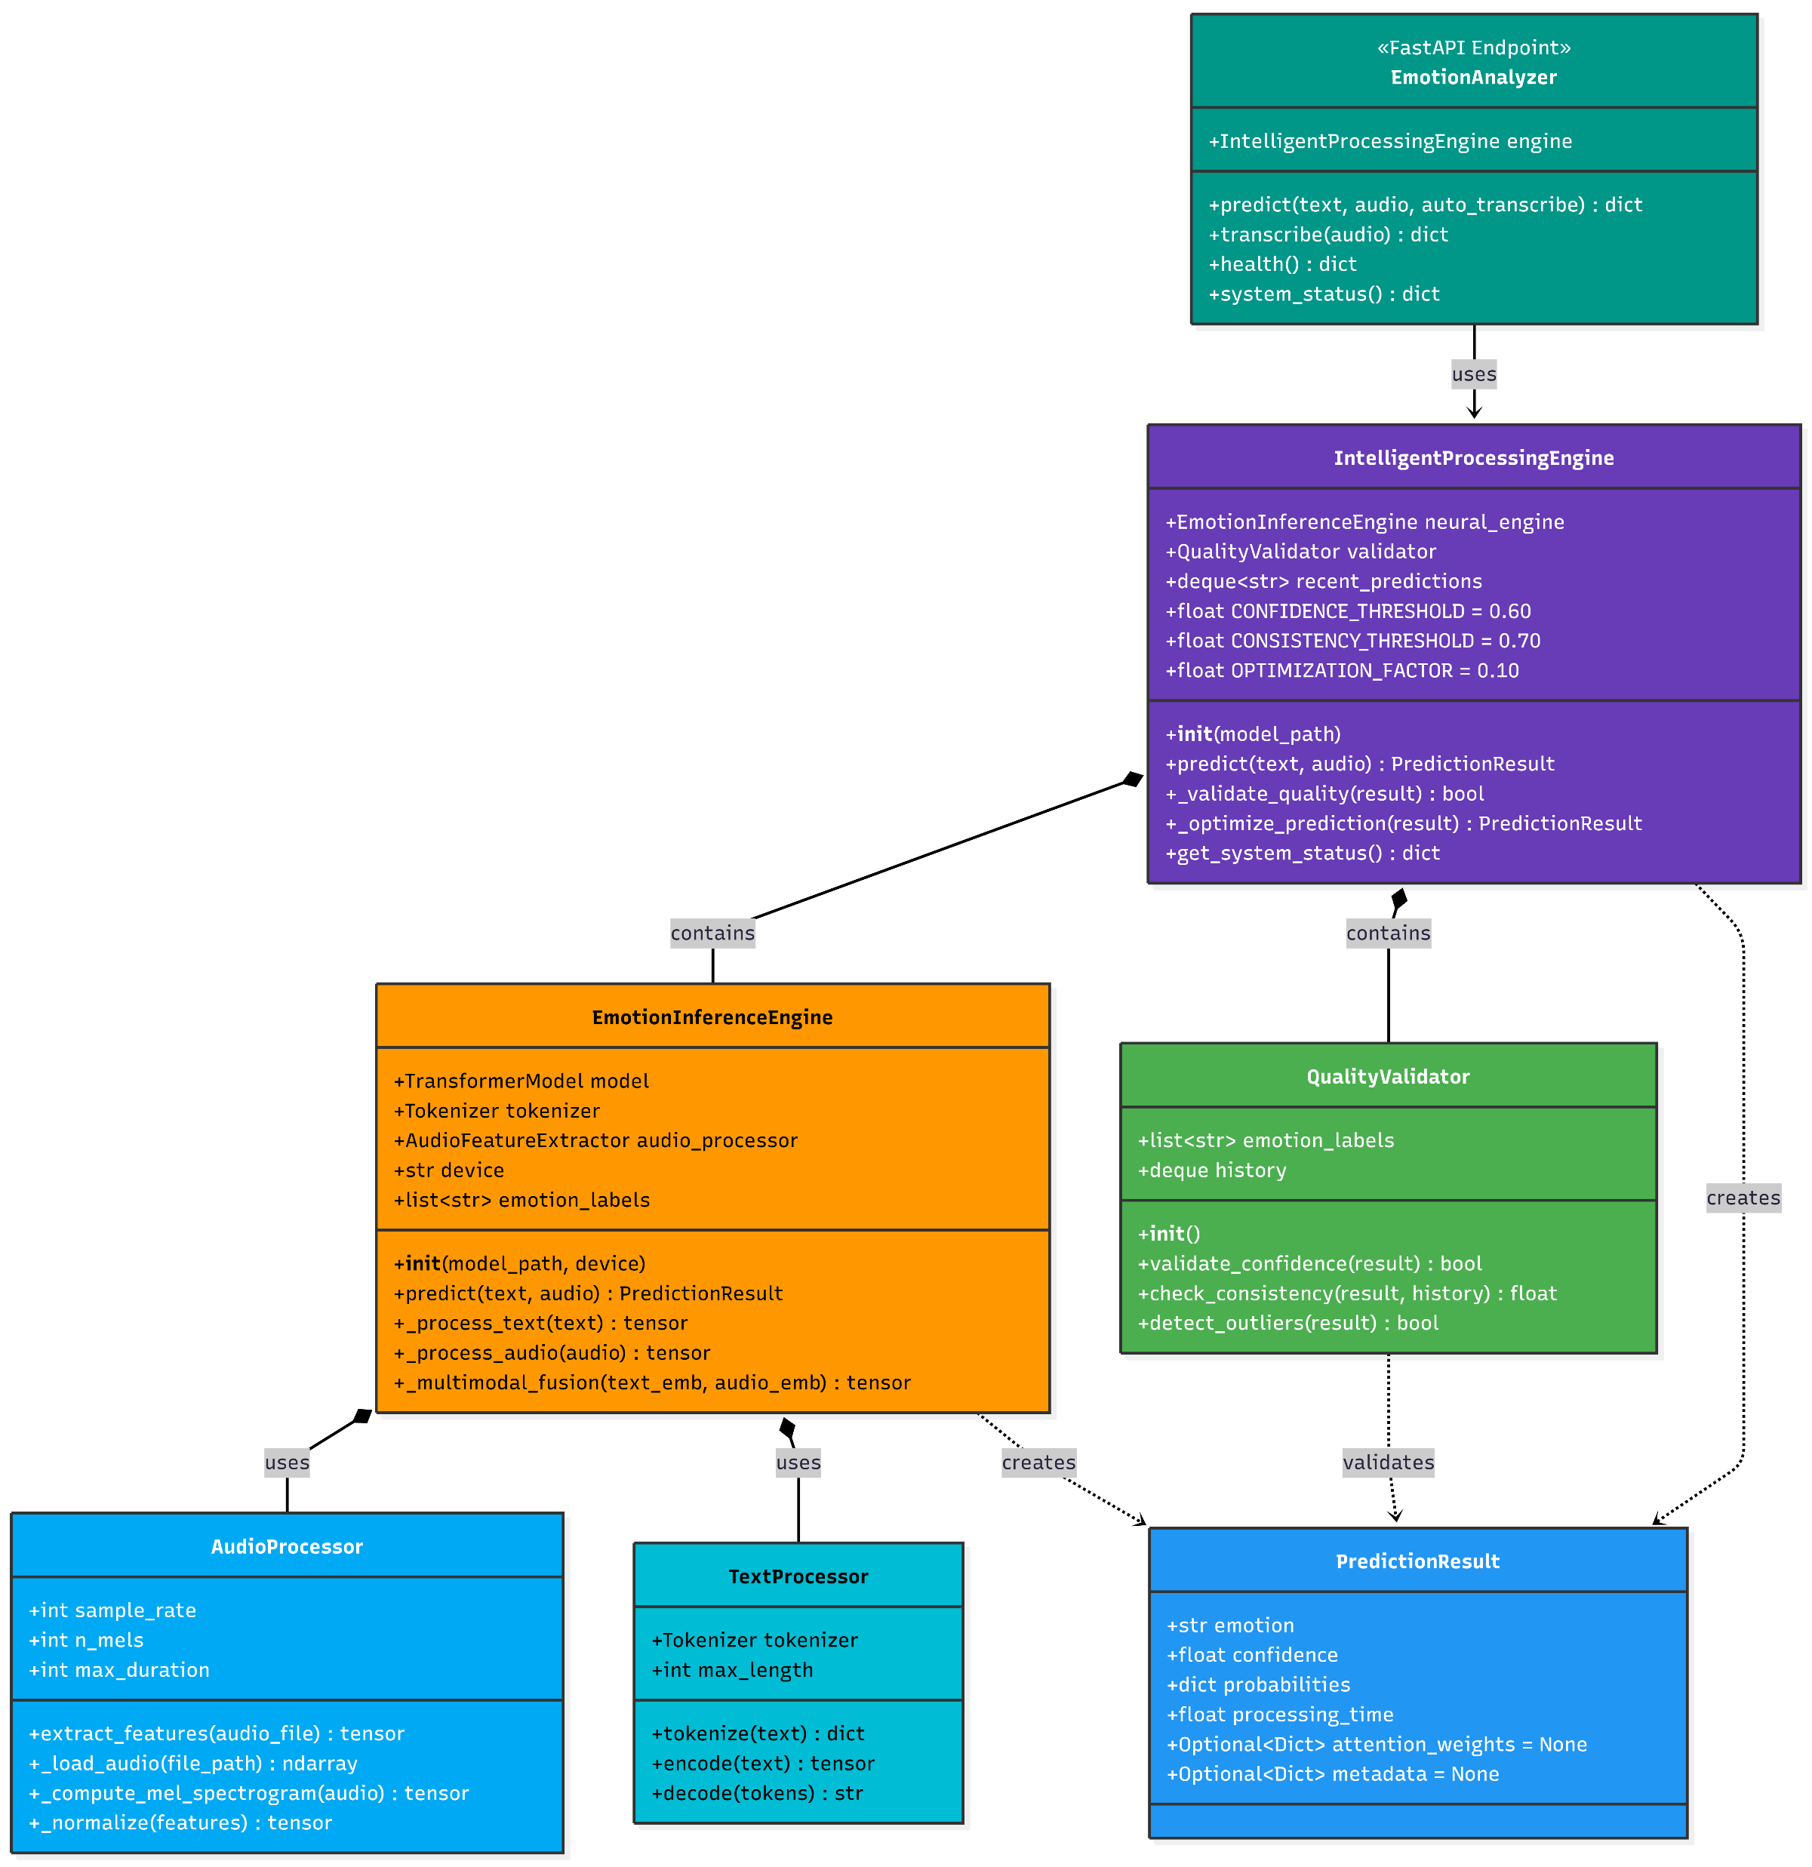
Class diagram
Department of Computer Science and Engineering, MCET

Slide 19
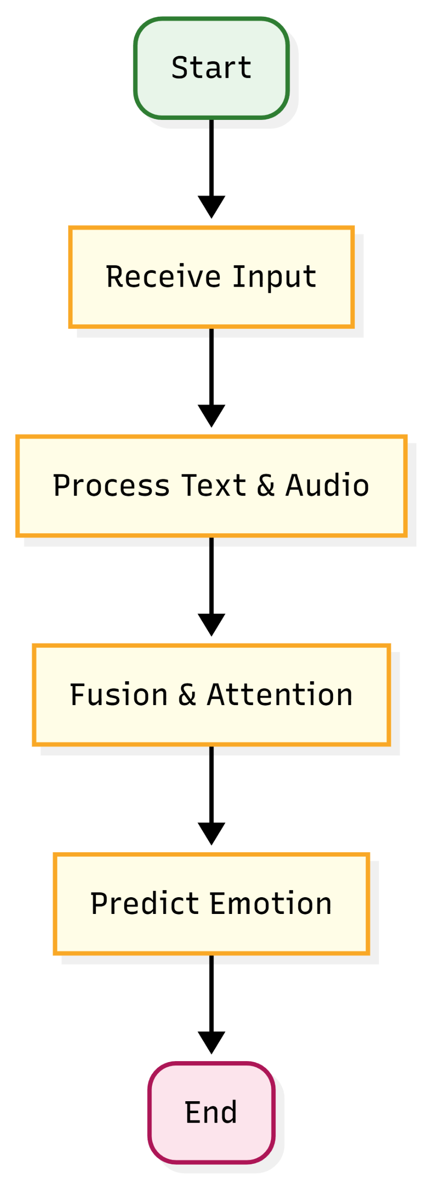
Activity Diagram
Department of Computer Science and Engineering, MCET

Slide 20
IMPLEMENTATION & RESULTS
DistilRoBERTa (82 million parameters) for text analysis
Wav2Vec2 XLSR-300M (317 million parameters) for audio analysis
Fused through a learned attention mechanism (6 million parameters)
Total system: 405 million parameters, achieving **87.6% F1 score** on the IEMOCAP and MELD emotion datasets.“
A. Text Processing Pipeline
Step 1: Tokenization
Step 2: Embedding
Step 3: Projection
B. Audio Processing Pipeline
Step 1: Audio Capture Step 2: Feature Extraction
Step 3: Projection
C. Attention-Based Fusion Mechanism
Unlike simple concatenation or averaging, attention learns which modality is more reliable for each input.
Text can be ambiguous ('I'm fine' - sarcasm?)
Audio can be noisy (background sound, poor mic)
Dynamic weighting adapts to input quality
D. Classification Layer
probabilities = softmax(x) # [p_happiness, p_sadness, p_anger]
prediction = argmax(probabilities) # Highest probability emotion
.
Department of Computer Science and Engineering, MCET

Slide 21
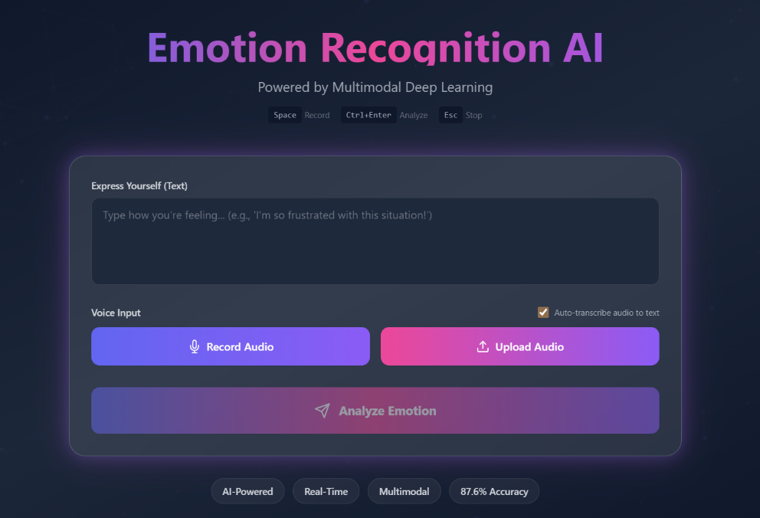
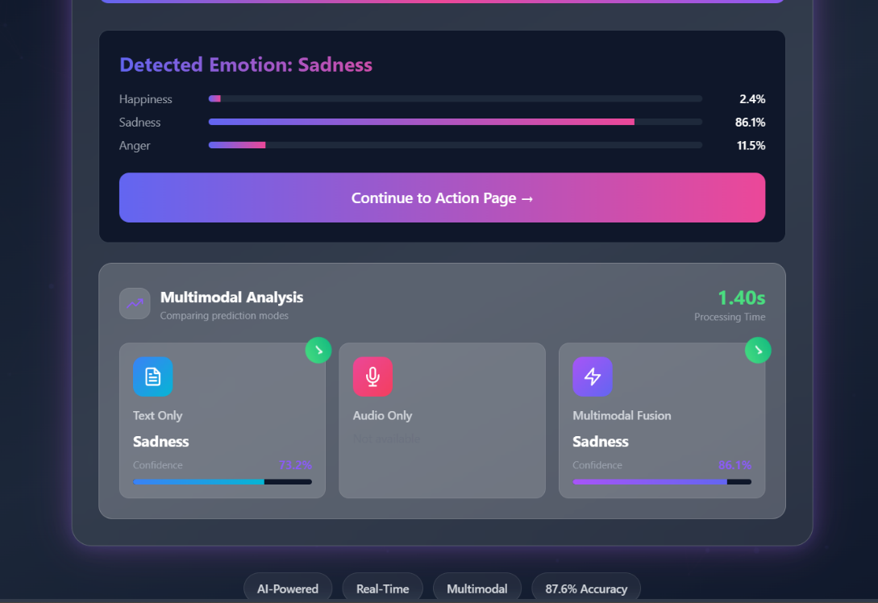

.
Dataset | Accuracy (%) | F1-Score (Macro) (%) | F1-Score (Weighted) (%)
Validation Set | 87.32 | 87.02 | 87.22
Test Set (Best Model) | 87.72 | 87.33 | 87.60
Department of Computer Science and Engineering, MCET

Slide 22
CONCLUSION
The project aims to develop an efficient and robust multimodal emotion recognition system that addresses the limitations of current transformer-based approaches, including high computational cost, sensitivity to noisy or missing modalities, and limited recognition of low-resource emotions.
By integrating lightweight hybrid fusion transformers with adaptive attention and modality reliability estimation, the framework ensures effective cross-modal learning and resilience in real-world environments.
The inclusion of targeted data augmentation and class-balancing strategies further enhances the model’s ability to generalize across diverse datasets and emotion categories.
Designed for scalability and real-time performance, the proposed system can be extended to various domains such as digital education, mental health assessment, and human–AI interaction, paving the way for more empathetic, efficient, and context-aware intelligent systems.
Department of Computer Science and Engineering, MCET

Slide 23
THANK YOU

